Slide 1
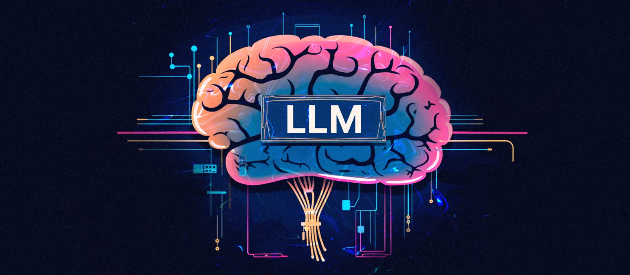

Slide 2
Definition of LLMs
Advanced AI models trained on vast amounts of text data to understand, generate, and process human language

Slide 3






Examples of popular LLMs

Slide 4
How LLMs Work
Transformer-based neural networks
Self-attention mechanism, encoder-decoder architecture (in some cases), multiple layers of transformers
Pre-training on large text corpora followed by fine-tuning on specific tasks
Transfer learning: LLMs can leverage knowledge gained from pre-training to adapt to various downstream tasks

Slide 5
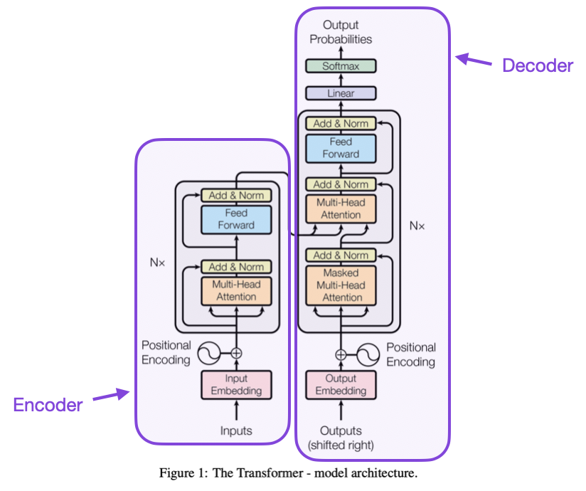
Transformer Architecture

Slide 6
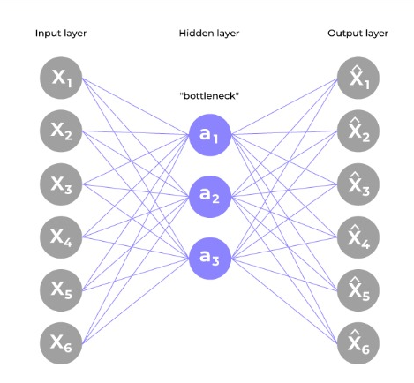
Auto encoder

Slide 7
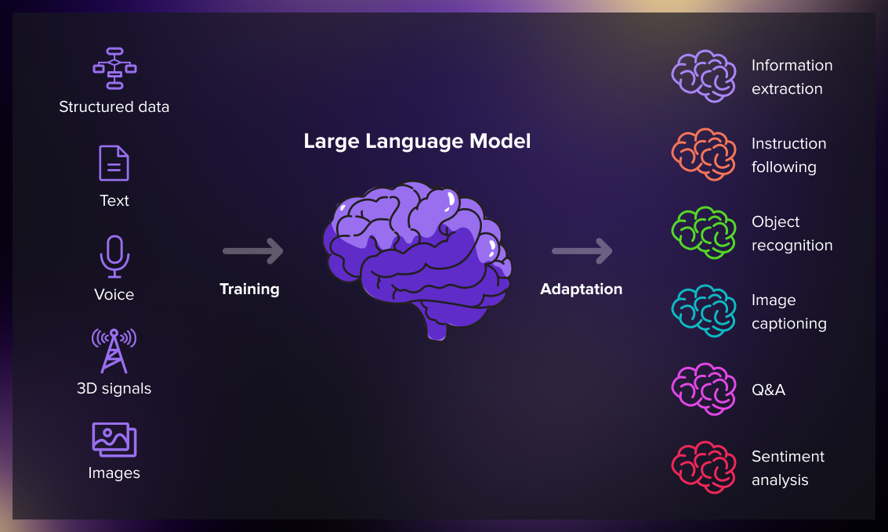

Slide 8
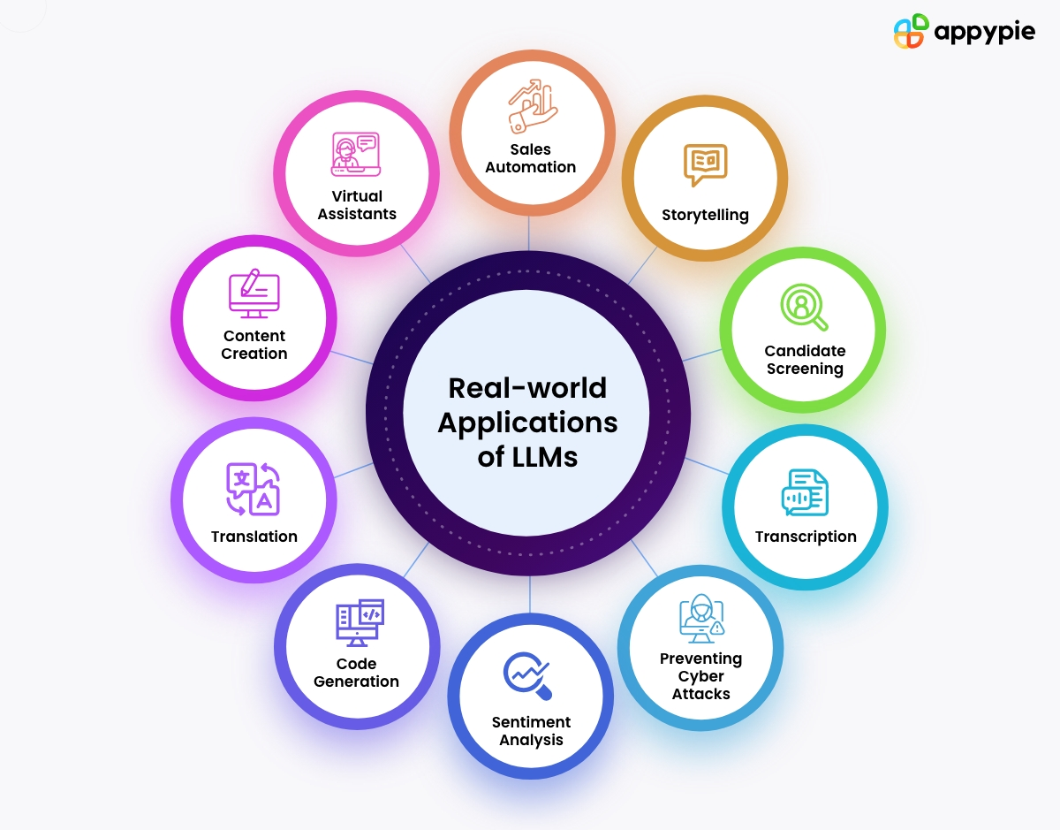
Potential Applications

Slide 9
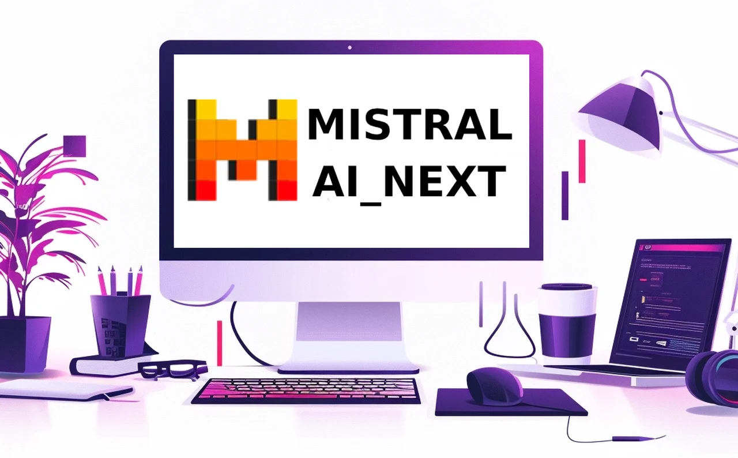
Live Demo
Colab :

Slide 10

